Slide 2

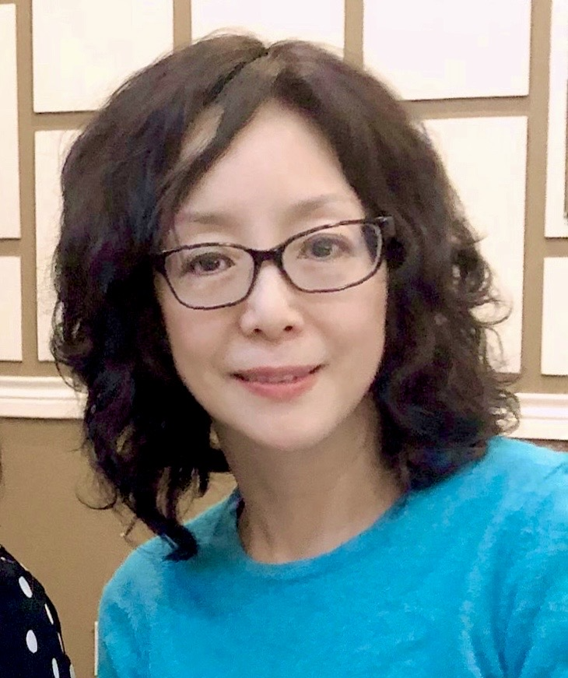
Simplilearn AI Engineer Program Instructor
Yang (Amber) Pan
Professional Experience:
  13 years of experience in IT consulting: data science, machine learning, software development, qa, and SAP R/3 implementations. Recent focus on Neural Network–based predictive modeling, LLM/GenAI & RAG applications.
  Machine learning model architect
  Lead project teams and developers in Softline, Bottle Rocket etc.
  Simplilearn trainer for AI and Machine Learning programs
Certifications and Education:
  Artificial Intelligence & Machine Learning Post Graduate Program, UT McCombs
  Applied Generative AI for Business Digital Transformation, MIT
  MBA/M.S. in Computer Systems Analysis, Miami University
  Dual degree in B.S. Material Science, B.A. Economics & Management, Tsinghua University
Award:
  DFW AI competition 2025 Silver Award
Interest Areas:
  Mathematics, Data Visualization, Deep Learning, Computer Vision, Generative AI
Notes:
Editing to be done by Faculty: Please update your Name, Photo and Key achievements.
Delivery: Walkthrough the learners on yourself such as achievements, key skills and experience.

